Slide 1
Lecture 2
Algorithm Analysis
How to predict an algorithm’s performance
Notes:
To solve a specific problem there are many different algorithms. Each algorithm can solve the problem, but which one is better? How can we tell an algorithm is good or not? We need to predict the performance of an algorithm.

Slide 2
Algorithm
Algorithm: a limit sequence of instructions used to solve some problems.
Program VS. Algorithm
  A computer program is an instance, or concrete representation for an algorithm in some programming language.

Slide 3
Algorithm Analysis
Metrics should be used to judge algorithms
  Length of the program (lines of code)
  Ease of programming (bugs, maintenance)
  Memory required
  Running time

Slide 4
An algorithm may run differently depending on:
  the hardware platform (PC, Cray, Sun)
  the programming language (C, Java, C++)
  The scale of the problem
We want to compare algorithms in terms of just what they are.
Crude but valuable measure of algorithm’s performance as a function of input size t(n) – time complexity
Analysis now defaults to time complexity analysis
  Quantifiable and easy to compare
  Time is “expensive” and often the critical bottleneck
Machine & compiler-dependent

Slide 5
Run Time Analysis
For most algorithms, running time depends on “size” of the input.
Running time is expressed as T(n): function T on input size n —— Time Complexity
Notes:
时间复杂度量度的单位是语法意义上的一个程序步。规定：
注释语句：程序步数为0；
声明语句：程序步数为0；（包括：定义常量变量，结构定义，函数特征声明，权限声明等）
不含函数的表达式：程序步数为1；
赋值语句：<变量>=<表达式>；赋值语句的步数取决于表达式的步数，如果表达式不包含函数调用，则步数为1，如果包含函数，则为函数调用的总步数。如果赋值语句的变量为数组，则赋值语句的步数为变量的大小+表达式步数；
循环语句：仅考虑循环控制语句的步数。对于“while<表达式>{...}”语句，循环控制步数为表达式步数；对于“for(<初始化语句>;<表达式1>;<表达式2>){...}”，第一次程序步数等于<初始化语句>+<表达式1>的步数之和，第二次及以后之后程序步数等于<表达式1>+<表达式2>的步数之和；
switch语句：执行步数等于switch条件中表达式的步数+某个条件满足的程序步数；
if语句：取决于满足条件部分语句的步数+辨别表达式的步数；
函数执行语句：一般步数为1；如果函数为递归调用，还要考虑函数中的局部变量；
new/delete/sizeof语句：步数为1；还要分析构造函数和析构函数的步数；
转移语句return,continue,break,goto：步数为1
*. 确定程序步数有两种方法：
一是可以设置一个全局的count变量，在每一个执行语句的附近改变count的值；
二是可以建立一个表，先列出每个语句执行一次的步数，再列出每个语句执行的次数，最后相乘得到各个语句的步数，加总即为总的程序步数。
*. 要确定一个程序的精确程序步数非常困难且不必要，因为程序步数本身就不是一个精确的概念（例如，x=a与x=a+b*c/d-e具有相同的程序步数），并不能确切反映运行时间，所以用准确的程序步数来判别算法的优劣并不是很有价值。因此，我们只需要得到一个数量级的估计值就可以了，也就是需要一个时间复杂度的渐进度量值，我们使用大O表示法：
T(n)=f(n)=O(n)
其中,T(n)为算法的时间复杂度，可以由一个函数f(n)来估计，而O()用来取f(n)的量级。大O表示法常用来分析算法在最坏情况下的时间代价，就是说当n充分大的时候，用大O方法来估计时间复杂度。大O方法主要关注关键操作，大部分的关键操作都存在于循环和递归中。
*. 大O表示法的规则：
1. 假设n充分大的时候，取最高次幂，eg. f(n)=2nE3+3nE2+4n+1，则T(n)=O(nE3)；
2. 加法规则：是针对几个并列的程序段，比如两个并列的循环，T1(n)=O(f(n)),T2(m)=O(g(m)),则整个程序段的时间代价为
T(n,m) = T1(n)+T2(m) = O(max{f(n),g(m)})
所谓max{f(n),g(n)}指的是，当n,m充分大的时候，f(n),g(m)的最大值，参考如下关系：
c < log2n < n < nlog2n < nE2 < nE3 < 2En < 3En < n!
----------------------- --------- ----------------
good efficiency ok effe very complicate
3. 乘法规则：针对多层嵌套的循环，关键操作应该在最内层循环中，应该自外向内层层分析每层循环的渐进时间复杂度，然后利用大O表示法的乘法规则来计算其渐进式间复杂度。比如，两个嵌套的循环，T1(n)=O(f(n)),T2(m)=O(g(m))，则整个程序段的时间代价为
T(n,m) = T1(n)*T2(m) = O(f(n)*g(m))
一个特例，如果T1(n)=O(c),T2(m)=O(g(m)),那么：
T(n,m) = T1(n)*T2(m) = O(c*g(m)) = O(g(m))
这说明,对任何正常数都属于一个数量级，O(1)。

Slide 6
What to Analyze
On which input instances should the algorithm’s performance be judged?
  Best case:
    Seems unrealistic
  Average case T_{avg}(N) :
    Real world distributions difficult to predict
  Worst case T_{worst}(N) :
    Gives an absolute guarantee
    We will use the worst-case measure.

Slide 7
Assumptions:
instructions are executed sequentially
each instruction is simple, and takes exactly one time unit
integer size is fixed and we have infinite memory

Slide 8
Example1. Matrix addition
void add ( int a[ ][ MAX_SIZE ],
int b[ ][ MAX_SIZE ],
int c[ ][ MAX_SIZE ],
int rows, int cols )
{
int i, j ;
for ( i = 0; i < rows; i++ )
for ( j = 0; j < cols; j++ )
c[ i ][ j ] = a[ i ][ j ] +b[ i ][ j ];
}
Q: What shall we do
if rows >> cols?
A: Exchange
rows and cols.
/*1+ rows+1 + rows */
/* rows(1+cols+1+cols) */
/* 2 ⋅ rows ⋅ cols */
T(rows, cols ) = 4 rows ⋅ cols + 4rows + 2

Slide 9
Example2. Iterative function for summing a list of numbers
float sum ( float list[ ], int n )
{ /* add a list of numbers */
float tempsum = 0;
int i ;
for ( i = 0; i < n; i++ )
tempsum += list [ i ] ;
return tempsum;
}
/* 1 */
/* 2n+2 */
/* 2n */
/* 1 */
T_{sum} ( n ) = 4n + 4

Slide 10

In fact there are no particular units of time.
I see ...
Then what’s the point of
this T_{p} stuff?
So it’s too complicated sometimes.
But does it worth the effort?
Is it really necessary
to count the exact
number of steps ?
Uhhh ...
I don’t think so.
Good question !
Let’s ask the students ...
Because
it drives me crazy!
Why?

Slide 11
The point of counting the steps is to predict the growth rate in run time as the N scales up, and thereby compare the time complexities of two programs.
Suppose T_{p1} ( N ) = N² +N and T_{p2} ( N ) = 10⁶N. Which one is better?
There will be an n₀ such that T_{p1} ( N ) > T_{p2} ( N ) for all N > n₀.

Slide 12
So what we really want to know is:
the big-Oh of T(N)

Slide 13
Asymptotic Notation
Big-O, “bounded above by”: T(n) = O(f(n))
  For some c and n₀, T(n) ≤ c·f(n) whenever n > n₀.
Compare their relative rates of growth.
The growth rate of T(n) is less than or equal to that of f(n)

Slide 14
Examples
O(n)
// f(n) = n
T(n) = 5n+2 = O(?)
  5n+2 ≤ 6n, for n ≥ 2 (C=6, n₀=2)
T(n)=n/2 –3 = O(?)
  n/2 –3 ≤ 0.5 n for n ≥ 0 (C=0.5, n₀=0)
T(n)=n²+n = O(?)
  n²+n ≤ 2n² for n ≥ 0 (C=2, n₀=0)
T(n)=n(n+1)/2 = O(?)
  n(n+1)/2 ≤ n² for n ≥ 0 (C=1, n₀=0)
O(n)
O(n²)
O(n²)

Slide 15
Asymptotic Notation
Big-Omega, “bounded below by”: T(n) = Ω(g(n))
  For some c>0 and n₀, T(n) ≥ c·g(n) whenever n > n₀.
  Same as g(n) = O(T(n)).
  The growth rate of T(n) is bigger than or equal to that of g(n)
Big-Theta, “bounded above and below”: T(n) = Θ(h(n))
  T(n) = O(h(n)) and also T(n) = Ω(h(n))
  The growth rate of T(n) is equal to that of f(n)
  T(n) = 5n+2=Θ(?) , T(n)=n(n+1)/2 =Θ(?)
Little-o, “strictly bounded above”: T(n) = o(p(n))
  T(n)/p(n) → 0 as n → ∞
  The growth rate of T(n) is less than that of f(n)

Slide 16
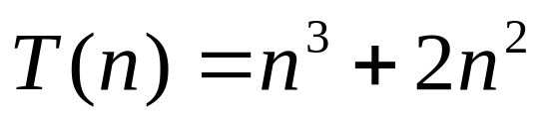
Example
n³+2n²=O(n³)=O(n⁴)=O(n⁵)= ⋅⋅⋅
We shall always take the smallest f (n).
n³+2n²= Ω(C)= Ω(n)= Ω(n²)= Ω(n³)
We shall always take the largest g(n).

Slide 17
Big-O Notation
(Common Complexities)
T(n) = O(f(n))
T(n)=O(1) // constant time
T(n)=O(log n) // logarithmic
T(n)=O(n) // linear
T(n)=O(nlog n) //loglinear
T(n)=O(n²) //quadratic
T(n)=O(n³) //cubic
T(n)=O(2^{n}), // exponential
T(n)=O(n!), // factorial
O(1)<O(㏒n)<O(n)<O(n㏒n)<O(n²)<O(n³)<O(2n)<O(n!)

Slide 18
Useful Rules of big-O estimation
Rule of sums
If T₁(n)=O(f(n)) and T₂(n)=O(g(n)), then
T₁(n)+T₂(n)=O(max(f(n),g(n)))
e.g. T₁(n)=5n³ , T₂(n)=n²+n
Rule of products
If T₁(n)=O(f(n)) and T₂(n)=O(g(n)), then
T₁(n)*T₂(n)=O(f(n)*g(n))
e.g. T₁(n)=(n-1)/2 , T₂(n)=n²
log^{k}n=O(n) for any constant k.
This tells us that logarithms grow very slowly.

Slide 19
Simplification Methods
T(n) = c_{k} n^{k} + c_{k-1} n^{k-1} + c_{k-2} n^{k-2} + … + c₁ n + c_{o}
If T(n) is the sum of a constant number of terms, drop all the terms except for the most dominant (biggest) term;
Drop any multiplicative factor of that term
What remains is the simplified f(n).
Notes:
K is independent of n

Slide 20
Common Formulas
1+2+3+…+n= n(n+1)/2 = O(n²).
1²+2²+3²+…+n²= n(n+1)(2n+1)/6 = O(n³)
1+x+x²+x³+…+x^{n}=(x ^{n+1} – 1)/(x-1) = O(x^{n}).

Slide 21
General rules of time complexity analysis
Since we are estimating the running time of a program in terms of Big-Oh, there are lots of shortcuts that can be taken without affecting the final answer.

Slide 22
simple statements (read, write, assign)
  The running time is constant O(1)
simple operations (+ - * / == > >= < <= ）
  The running time is constant O(1)
sequence of simple statements/operations
  the runtime is dominated by the most expensive operation

Slide 23
For, DO & WHILE LOOPS
  The running time is at most the running time of the statements inside the for loop (including tests) times the number of iterations.
  for (i=1; i<n; i++)
    { statements； }
  for (i=1; i<n; i++)
    if A(i) > maxVal then
      { maxVal= A(i);
      maxPos= i; }
Asymptotic Complexity:T(n)=O(n)

Slide 24
NESTED FOR LOOPS:
  The total running time of statements inside a group of nested loops is the running time of the statements multiplied by the product of the sizes of all the for loops.
  for (i=1; i<n; i++)
  for(j=1;j<n;j++)
    { statements； }

Slide 25
Exercises:
for (i=1;i<n;i++){
for (j=1;j<=i;j++){
for(k=1;k<=j;k++)
x++;
}
}
int y=5;
while((y+1)*(y+1)<n)
y++;
}
  for (i=1; i<＝n; i++)
    for (j=n; j>= i; j--)
      if (A[j-1] > A[j]) then
        temp = A[j-1];
        A[j-1] = A[j];
        A[j] = tmp;
      endif
    endfor
  endfor
void fun(int n)
{
int i=0,s=0;
while(s<n)
{
++i;
s=s+i;
}
}

Slide 26
Exercises:
int Fun (int n)
{
count=0; x=2;
while (x<n/2) {
x*=2;
count++;
}
return count;
}
If x=10?

Slide 27
IF / ELSE:
For the fragment
if ( Condition ) O(1)
S1; T₁(n)
else S2; T₂(n)
  the running time is never more than the running time of the test plus the larger of the running time of S1 and S2.
  T(n)=O(max(T₁(n),T₂(n))
Method calls
  A calls B
  B calls C
  etc.
  A sequence of operations when call sequences are flattened
  T(n) = max(T_{A}(n), T_{B}(n), T_{C}(n))

Slide 28
Example: Factorial
int factorial1(int n) {
if (n<=1) return 1;
else {
fact = 1;
for (k=2;k<=n;k++)
fact *= k;
return fact;
}
}
O(n).
// O（1）
// O（1）
// O（n）
// O（1）

Slide 29
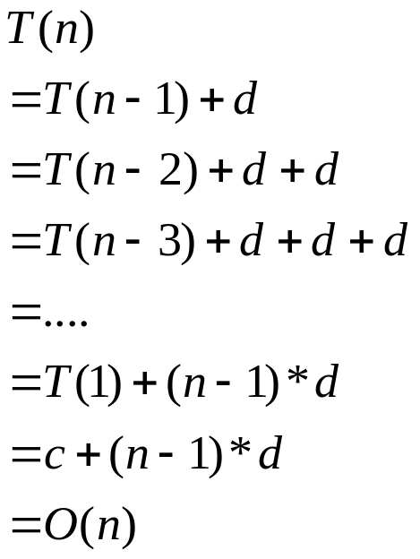
Example: Factorial (cont.)
int factorial (int n) {
if (n<=1) return 1;
else return n * factorial(n-1);
}
Asymptotic Complexity:T(n)=O(n)

Slide 30
The Recursive Code of Binary Search
int binarySearch(double b, double X[], int left, int right)
{
if (left == right)
if (b==X[left]) return left;
else return -1;
int mid = (left+right)/2;
if (b==X[mid]) return mid;
if (b < X[mid]) return binarySearch (b, X, left, mid);
if (b > X[mid]) return binarySearch(b, X, mid+1, right);
}

Slide 31
Time Complexity of binarySearch
Call T(n) the time of binarySearch when the array size is n.
T(n) = T(n/2) + c, where c is some constant representing the time of the basis step and the last if-statement to choose between min1 and min2
Assume for simplicity that n= 2^{k}. (so k=log₂ n)
T(2^{k})=T(2^{k-1})+c=T(2^{k-2})+c+c=T(2^{k-3})+c+c+c = … = T(2⁰)+c+c+…c=T(1)+kc=O(k)=O(log n)
Therefore, T(n)=O(log n).

Slide 32
Time Complexity of Sequential search
int Seqsearch(double b, double X[], int n)
{
for (i=0;i<n;i++)
if X[i]==b return i;
return 0;
}
Sequential search: T(n)=O(n)
Binary search: T(n)=O(log n)

Slide 33
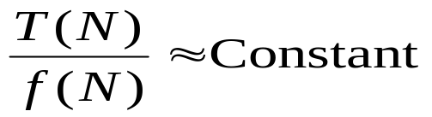
Checking Your Analysis (I)
When T(N) = O(N),
When T(N) = O(N²),
When T(N) = O(N³),
Method 1
check if T(2N)/T(N) ≈ 2
check if T(2N)/T(N) ≈ 4
check if T(2N)/T(N) ≈ 8
… …
Method 2
When T(N) = O( f (N) ), check if
for a range of N
Read the example given on p.28 (Figures 2.12 & 2.13).

Slide 34
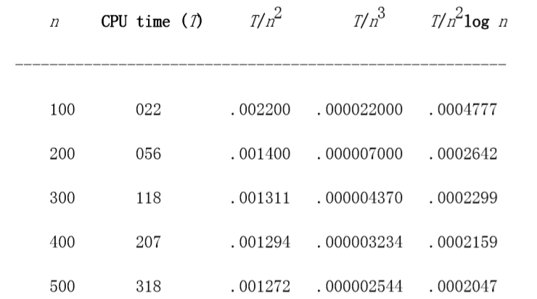
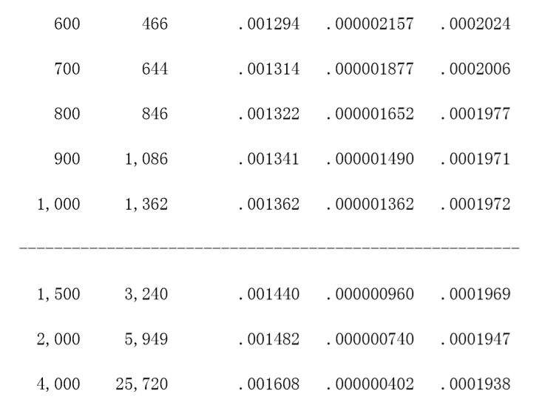

Slide 35

Max Subsequence Problem
Given a sequence of integers A1, A2, …, An, find the maximum possible sum of a subsequence Ai, …, Aj:
Numbers can be negative.
You want a contiguous chunk with largest sum.
Example: -2, 11, -4, 13, -5, -2
The answer is 20 (subseq. A2 through A4).
We will discuss 4 different algorithms, with time complexities O(n³), O(n²), O(n log n), and O(n).
With n = 10⁶, algorithm 1 may take > 10 years; algorithm 4 will take a fraction of a second!
Max sum is 0 if all the integers are negative.

Slide 36

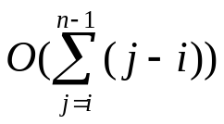
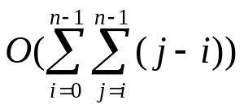

Algorithm 1 Mathod of Exhaustion
（穷举法）
Given a[0],…,a[n-1] , find the maximum value of a[i]+a[i+1]+···+a[j] ; 0 if the max value is negative
int maxSum = 0;
for( int i = 0; i < n; i++ )
for( int j = i; j < n; j++ )
{
int thisSum = 0;
for( int k = i; k <= j; k++ )
thisSum += a[ k ];
if( thisSum > maxSum )
maxSum = thisSum;
}
return maxSum;
Time complexity: O(n³)

Slide 37
Algorithm 2
Idea: Given sum from i to j-1, we can compute the sum from i to j in constant time.
This eliminates one nested loop, and reduces the running time to O(n²).
int maxSum = 0;
for( int i = 0; i < n; i++ )
int thisSum = 0;
for( int j = i; j < n; j++ )
{
thisSum += a[ j ];
if( thisSum > maxSum )
maxSum = thisSum;
}
return maxSum;
Time complexity: O(n²)

Slide 38
Algorithm 3 Recursion
This algorithm uses divide-and-conquer paradigm.
The base case
Suppose we split the input sequence at midpoint.
The max subsequence may be
  entirely in the left half,
  entirely in the right half,
  straddles the midpoint.
Max subsequences in each half found by recursion
conquer
divide

Slide 39
Algorithm 3 (cont.)
Example:
left half right half
4 -3 5 -2 -1 2 6 -2
Max in left is 6 (A1 through A3);
Max in right is 8 (A6 through A7).
Straddling max is 11 (A1 thru A7).

Slide 40
Algorithm 3 (cont.)
4
−3
5
−2
−1
2
6
−2
4
5
2
6
6
8
11
T ( N/2 )
O( N )
T ( N/2 )
T ( N ) = 2 T( N/2 ) + c N , T(1) = O(1)
The program can be found on Fig. 2.7.
Also true for N ≠ 2^{k}
= 2 [2 T( N/2² ) + c N/2] + c N
= 2^{k} O(1) + c k N where N/2^{k} = 1
= O( N log N )

Slide 41
Algorithm 4
Observations:
Max subsequence cannot start or end at a negative Ai.
More generally, the max subsequence cannot have a prefix with a negative sum.
Thus, if we ever find that Ai through Aj sums to < 0, then we can advance i to j+1

Slide 42
Algorithm 4(cont.)
int maxSum = 0, thisSum = 0;
for( int j = 0; j < a.size( ); j++ )
{
thisSum += a[ j ];
if ( thisSum > maxSum )
maxSum = thisSum;
else if ( thisSum < 0 )
thisSum = 0;
}
return maxSum;
}
−1
−1
3
3 −2 4 −6
−2
4
−6
1
6
−1
Time complexity clearly O(n)

Slide 43

Running times of several algorithms for maximum subsequence sum (in seconds)
Algorithm
1
2
3
4
Time
O( N³ )
O( N² )
O(N log N)
O( N )
Input Size
N =10
N =100
N =1,000
N =10,000
N =100,000
0.00103 0.47015
448.77
NA
NA
0.00045
0.01112
1.1233
111.13
NA
0.00066
0.00486
0.05843
0.68631
8.0113
0.00034
0.00063
0.00333
0.03042
0.29832
With n = 10⁶,
algorithm 1 may take > 10 years;
algorithm 4 will take a fraction of a second!

Slide 44
〖Example〗 Exponentiation: computing X ^{N}.
long int Pow ( long int X, unsigned int N )
{
long int P = 1;
while ( N -- ) P *= X;
return P;
}
T( N ) = O( N )
long int Pow ( long int X, unsigned int N )
{
if ( N == 0 )
return 1;
else
return Pow( X , N-1)*X;
}
T( N ) = O( N )

Slide 45
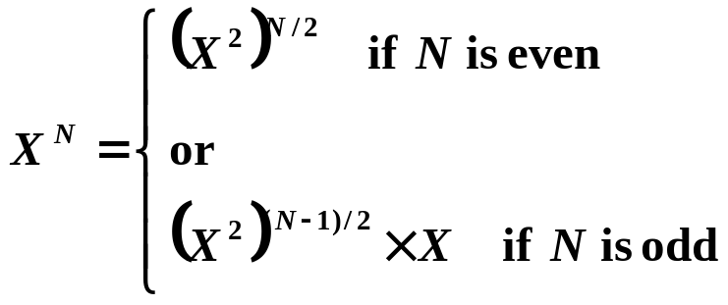

〖Example〗 Exponentiation: computing X ^{N}.
long int Pow ( long int X, unsigned int N )
{
/* 1*/ if ( N == 0 )
/* 2*/ return 1;
/* 3*/ if ( N == 1 )
/* 4*/ return X;
/* 5*/ if ( IsEven( N ) )
/* 6*/ return Pow( X * X, N / 2 );
else
/* 7*/ return Pow( X * X, N / 2 ) * X;
}
return Pow( Pow(X, 2), N / 2 );
Is it necessary ?
return Pow( Pow(X, N / 2), 2);
return
Pow(X, N / 2) * Pow(X, N / 2);
T( N ) = O( log N )

Slide 46
Homework
2.1, 2.2, 2.5, 2.6, 2.9, 2.10

